Slide 1

Woodland University College -Blackhorse Software and Solutions GROUP- H

Slide 2
Table of content
-Background
-Introduction
-Aims
-Project development Methodologies
-Problem domain and interview findings
-Designing and analyzing phase
-Comparable System Review
-Proposed solutions and features
-Design Constraints
-Access Rights
-Wireframes and Mockups
-Conclusions and references

Slide 3
Background
The Woodland University is small higher Education institution.
Providing wide range of degree courses.
Using clerical system, including clerical documentation.
All the employees have different roles and responsibilities in the university.

Slide 4
Aims/Objective
To computerize the current clerical system.
To improve security system
Assessable only by valid member of the university
Effective record management.
Extra features to manage up to date data

Slide 5
Project Development Methodologies
It is a framework that is used to structure ,plan and control the process of developing information system.
Categorized into four parts:
Interviews
Problem Domain
Water fall methodology
System Design and Testing
Presentation

Slide 6
Water fall Methodology
Traditional sequential design process
Requirements are clearly defined.
Simple and easy to understand and use.

Slide 7
Problem Domain and Interview Findings
Data Redundancy
Data Loss
Security Issues
Lack of storage space
Limited Collaboration
Need of high skilled manpower.

Slide 8
Designing And analyzing phase
Secure
More efficiency
Decreases the issues and problem
Simple and user friendly

Slide 9
Comparable Software System Review
System design analysis
Functions present in system
System advantage and drawbacks
Focus point in system

Slide 10
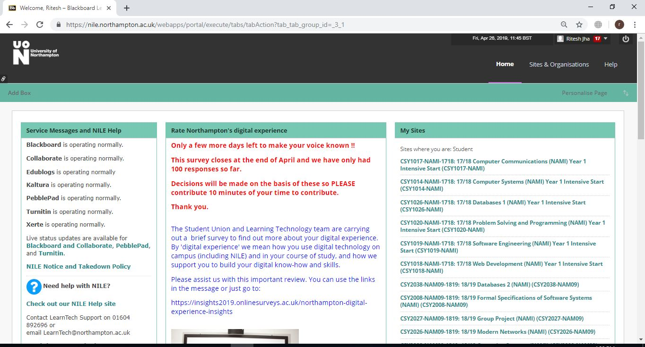
NILE
Pros
Pros the theme color is eye friendly.
Modules are displayed properly.
Personalize option is provided to user.
More information's are placed
Cons
Search option is missing
Modules are displayed in which students are not enrolled.
https://nile.northampton.ac.uk

Slide 11
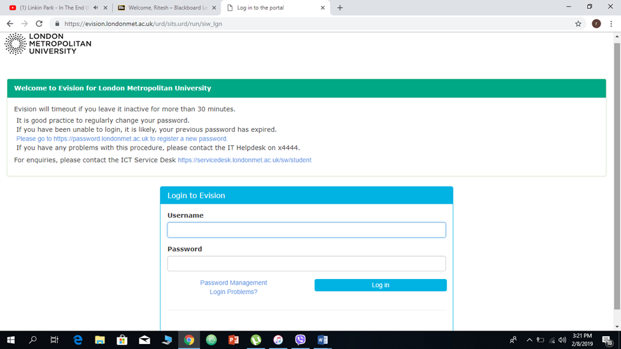
London Metropolitan University
Pros
Easy to operate
Eye friendly color
User-friendly interface
Cons
Not so effective design,
Minimal functional design,
https://evision.londonmet.ac.uk

Slide 12
Proposed Solution And Features
Three levels of data control.
ADMIN:
-Able to add students in system through csv file,
-Send concern letter to student and assign module to students,
-Manage staff, module, course leaders,
STAFF
-Manage module, attendance, assessment, assign grades
STUDENT
-View module, submit assessments, attendances, etc.

Slide 13
Design Constraints
Design constraints are the constraints which are used for solution of the design and have significant impact on design.
Design constraints was made as demand or fulfillment of the company.
Font: Montserrat", "Helvetica Neue", Helvetica, Arial
Font Size:- Heading= 16, Body = 12
Background color is bluish, blue white combination
New standard Features
Separate profile for each user,
Same login page for all users,
Responsive design,

Slide 14
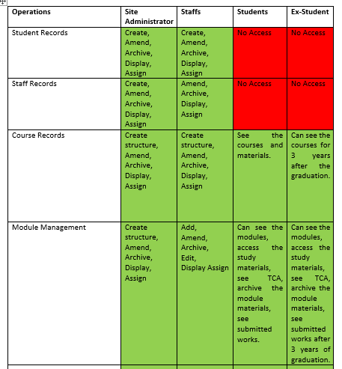
Access Rights

Slide 15
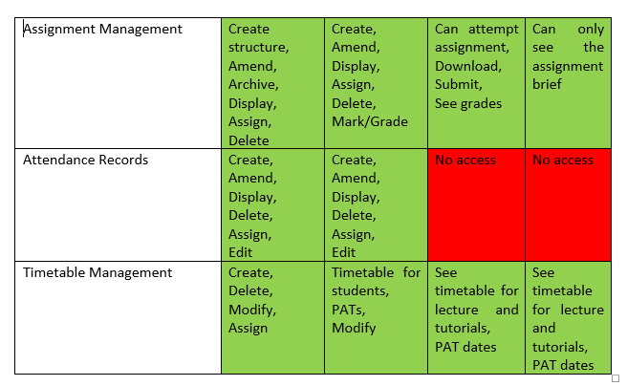

Slide 16
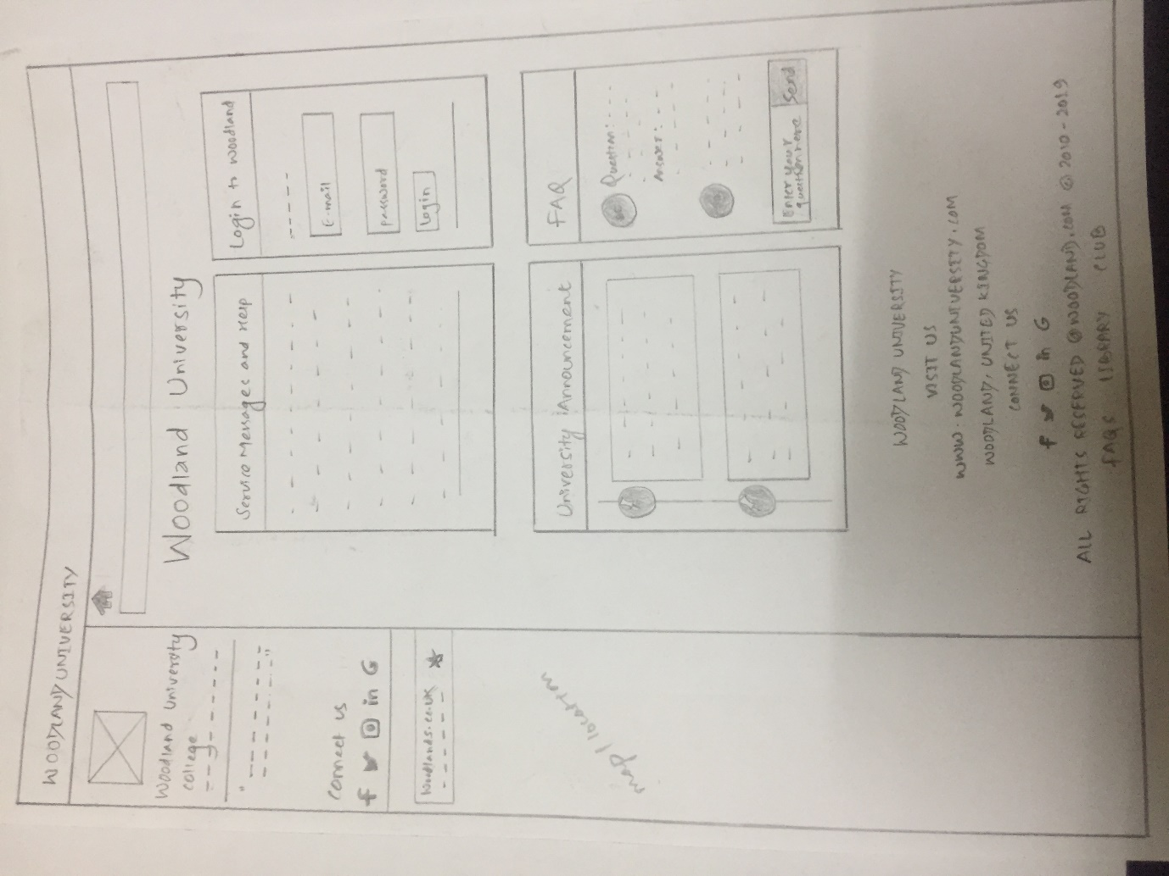
Wireframe: Home Page

Slide 17
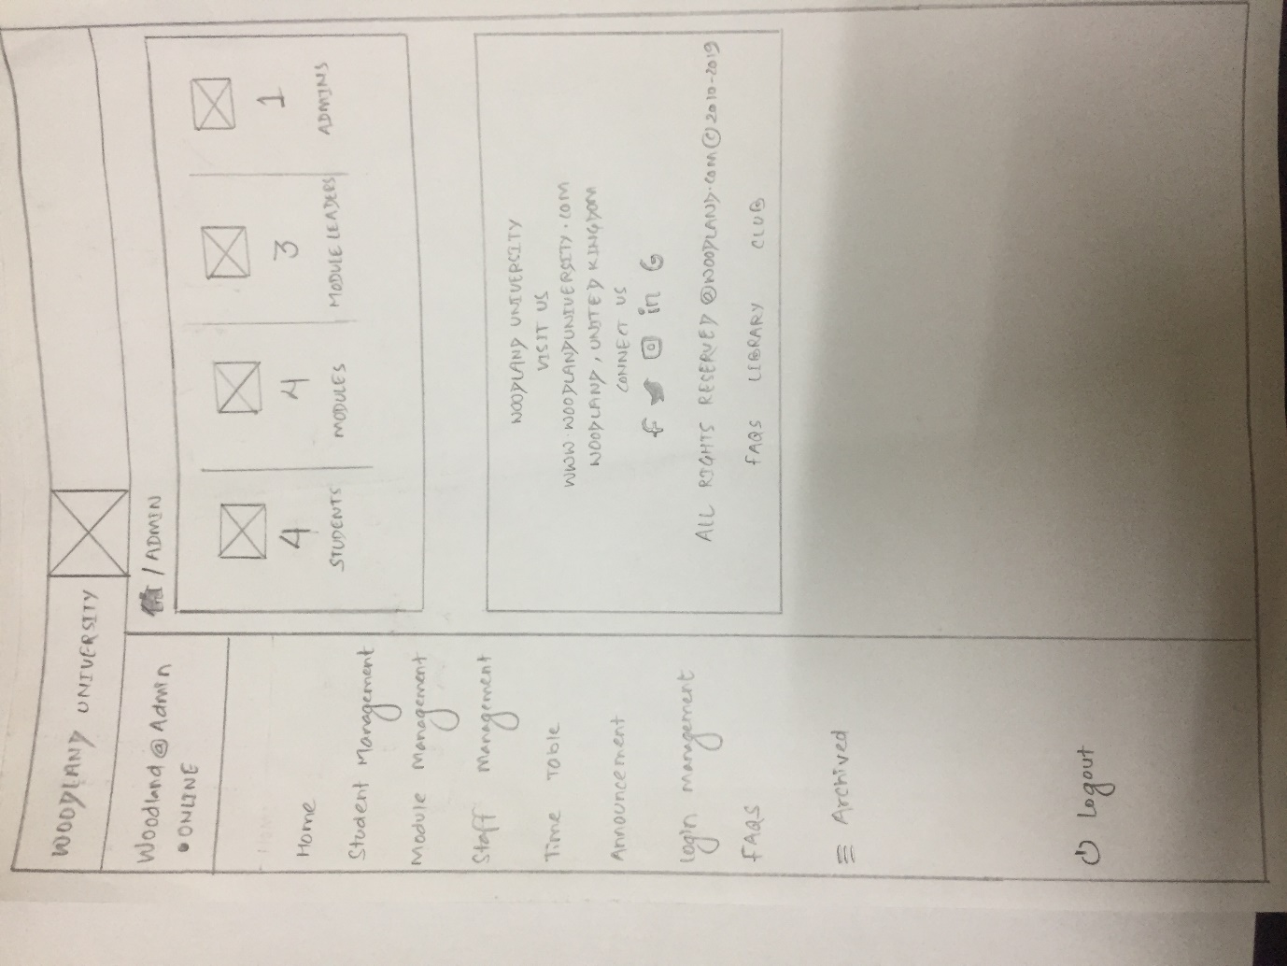
Wireframe: Admin Page

Slide 18
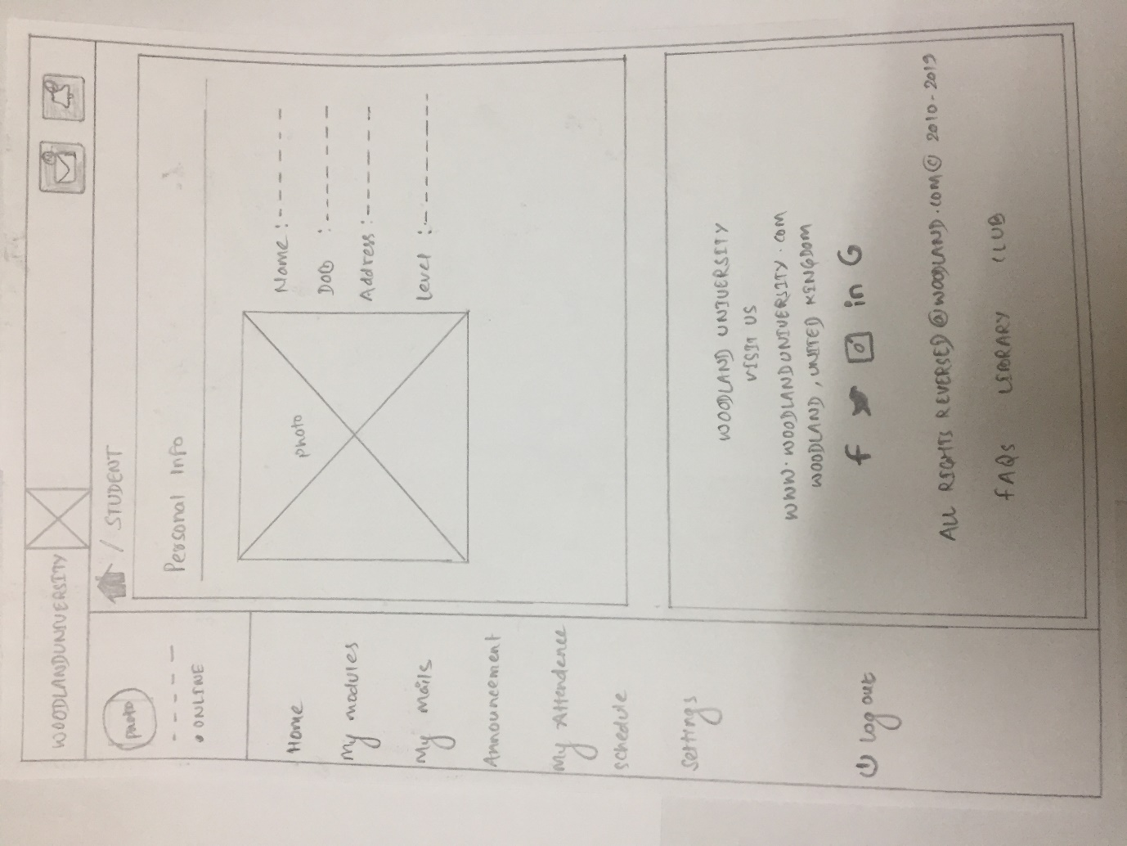
Wireframe: student Page

Slide 19
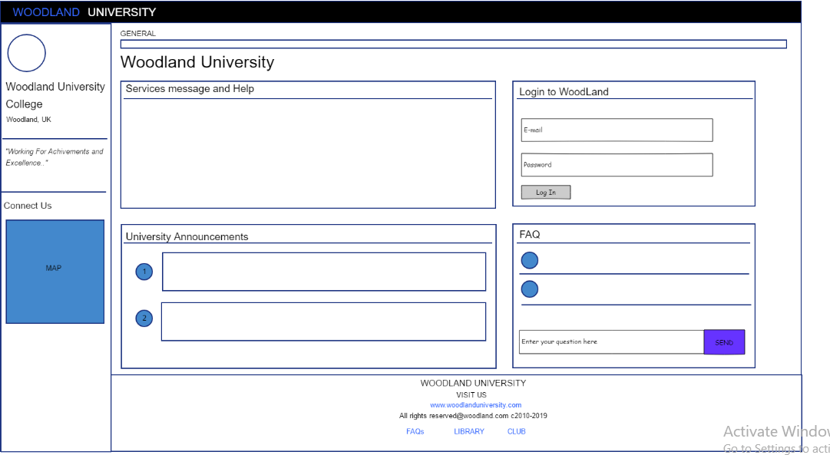
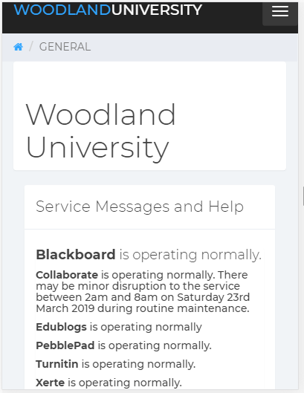
Mockups

Slide 20
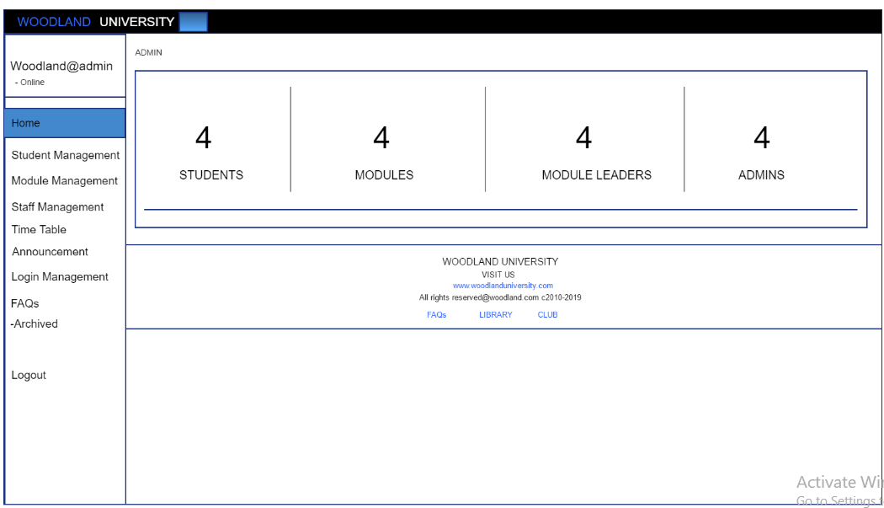
Mockup :Admin Page

Slide 21
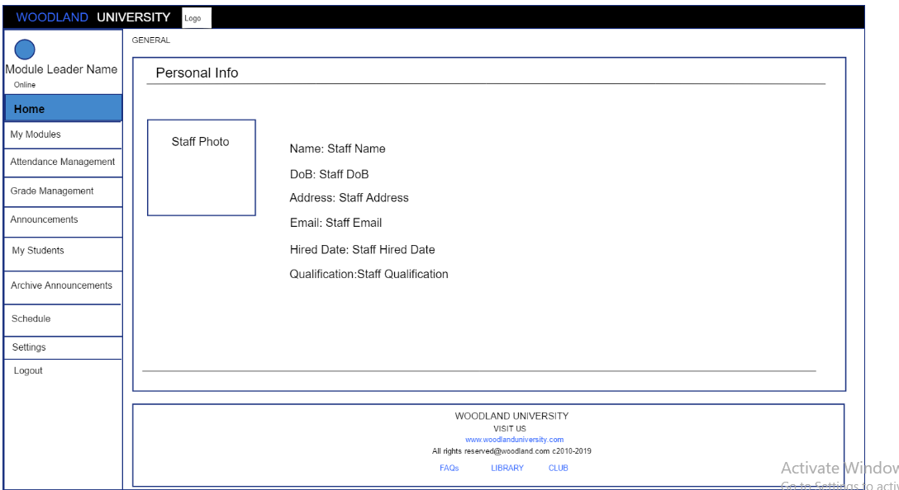
MockUp-Staff page

Slide 22
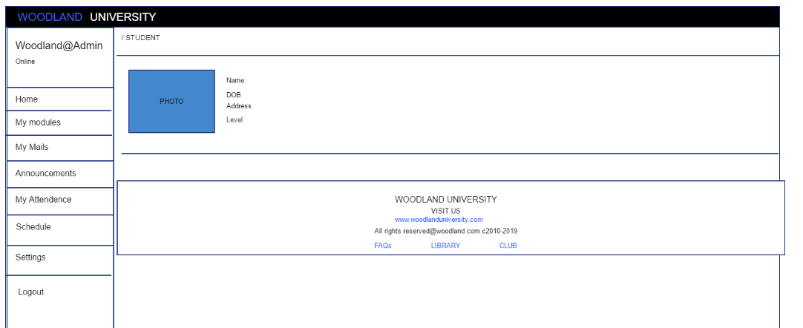
Mockup :student Page

Slide 23
Conclusion
1. Efficient management
2. Personalization
3. Saving time and money
4. Easy assess to information.
5. Up to date and immediate content

Slide 24
References
1. CAE Computer Aided E-learning. 2019. 9 Advantages of Learning Platforms or LMS. [ONLINE] Available at: https://www.cae.net/lms-learning-platforms-advantages/. [Accessed 26 April 2019].
2. Simplicable. 2019. 9 Types of Design Constraint - Simplicable. [ONLINE] Available at: https://simplicable.com/new/design-constraints. [Accessed 26 April 2019]
3. Wikipedia. 2019. Pilot Software - Wikipedia. [ONLINE] Available at: https://en.wikipedia.org/wiki/Pilot_Software. [Accessed 26 April 2019]
4. Wireframes Vs Mockups: what's the best? - Justinmind. 2019. Wireframes Vs Mockups: what's the best? - Justinmind. [ONLINE] Available at: https://www.justinmind.com/blog/wireframes-and-mockups-whats-the-best-option/.
5. TechSpot. 2019. System Mechanic Free 18.0.2.486 Download - TechSpot. [ONLINE] Available at: https://www.techspot.com/downloads/5283-system-mechanic-free/similar/s-whats-the-best-option/. [Accessed 26 April 2019].

Slide 25
Team Members
Shivani Purwar- Team Leader
Ramesh Kuwar
Suman Chaulagain
Anup Thapa
Madhu Sudan Rana
Chirayu Subedi
Subesh Thapa
Ritesh Jha
Siddhant Ghimire

Slide 26
THANKS!
Any Queries ?
You can find us at
blackhourse.uk@gmail.com

